Slide 1

Opening new Coffee Shops in Chicago

Slide 2
Chicago Community Areas
Chicago is broken into 77 community areas that are utilized for various functions, including urban planning and business decisions
The community areas are comprised of several neighborhoods, and wards, or the political voting unit, may span community areas
My clients want to open one or more new coffee shops in Chicago
I will utilize the Chicago community areas to examine the best community area(s) in which to open coffee shops

Slide 3
Community Area Data
Population information about community areas was acquired from Wikipedia; the population data is from 2017
Location coordinates or community areas were acquired from GitHub
Venue information was acquired utilizing the Foursquare API
Data cleaning steps included:
Identifying a central coordinate for latitude and longitude
Converting string variables to numeric
Converting venue information into variables

Slide 4
Descriptive Visuals

Slide 5
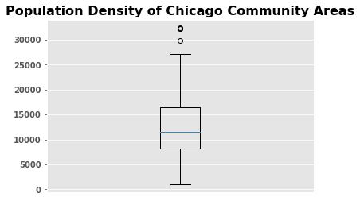
Box and Whisker Plot
The box and whisker plot identifies four community areas that are outliers in terms of population density per square mile:
Near North Side – 32,442.70
Lake View - 32,201.92
Edgewater – 32,163.79
Rogers Park – 29,925
Community areas with a high population density are viable candidates for new coffee shops due to the large population in a small area.

Slide 6
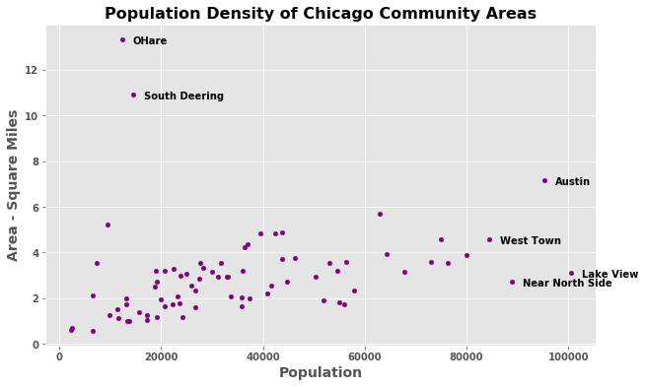
Scatterplot
The scatterplot further cements Lake View and Near Northside as community areas of interest, but also add Austin and West Town. While Austin and West Town have a greater area, they still have large populations.
O’Hare and South Deering should not be considered due to their low populations and large areas.

Slide 7
Venues

Slide 8
Venue Identification
Community Area | Coffee Shop
Austin | 9th most common venue
Edgewater | N/A
Lake View | N/A
Near North Side | N/A
Rogers Park | 10th most common venue
West Town | 6th most common venue
Merging in venue information from Foursquare provided additional information about the neighborhoods of interest, particularly showing which already have many coffee shops

Slide 9
K-Means Clustering
K-Means clustering was also conducted to group community areas by their common venues
Cluster 3 was dominated by community areas with many restaurants
Additionally, any community areas in Cluster 3, save O’Hare or community areas that already have many coffee shops, are viable choices

Slide 10
Conclusion
We recommend our clients open new coffee shops in one of the following community areas: Edgewater, Lake View, or Near North Side.

